Slide 1
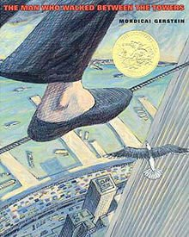
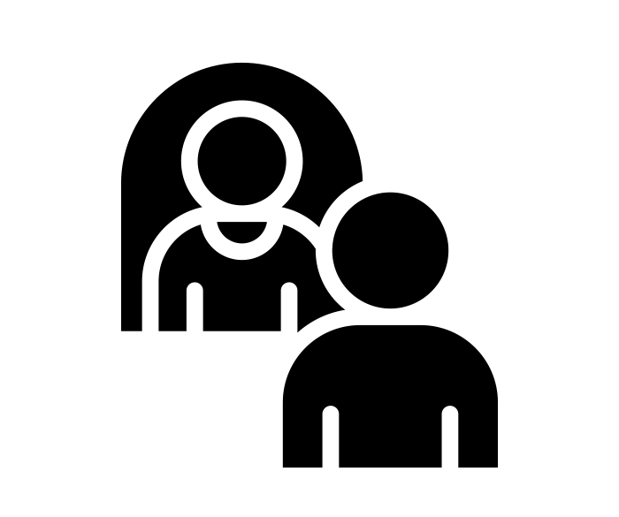
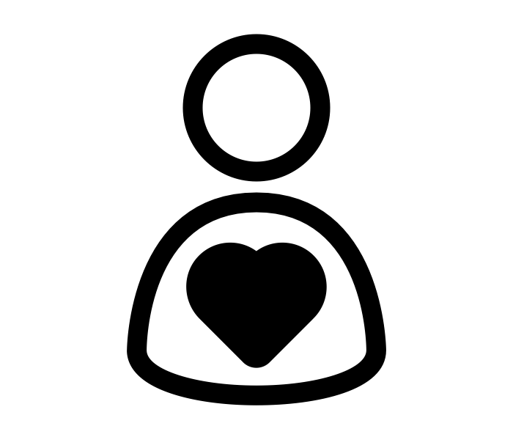
Year 6 | Autumn Term
Bravery Citizenship Curiosity Gratitude Integrity Kindness

